Slide 1
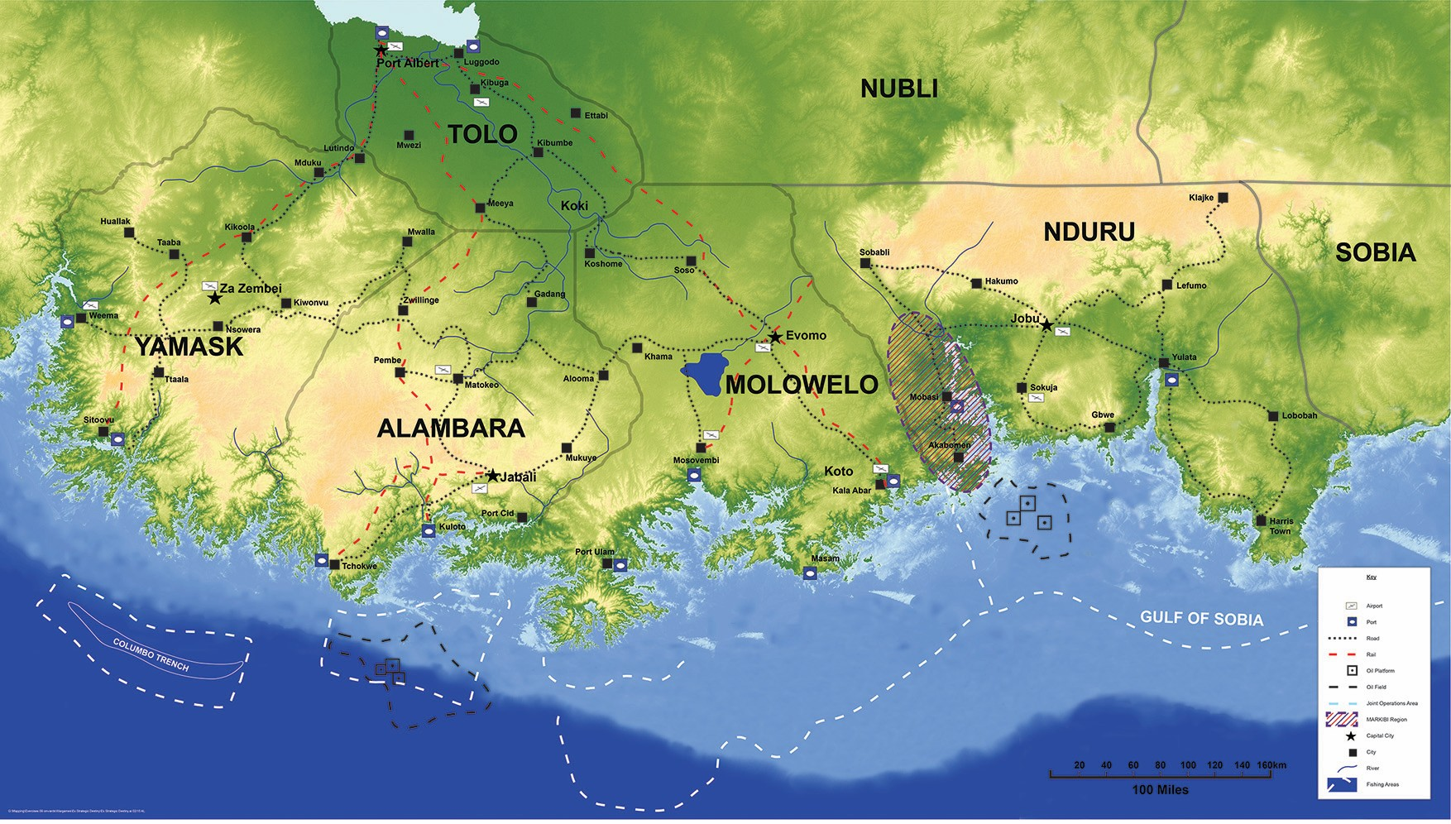











Routes
Route Purple (Road) – 350miles
Route Blue (Rail) – 60miles
Route Red (Rail) – 120miles
Route Orange (Rail) – 340miles
Route Yellow (Sea) – 200miles
Route Brown (Sea) – 320miles
r

Slide 2










Strategic
Reception
Staging
Onward Movement
Kilkoola
Port Albert
180miles
240miles
Zwillinge
80miles
80miles
Weema
40miles
60miles
60miles
North of Ttaala
Kiwonvu
Sitoovu
60miles
320miles
40miles
Kuloto
Jabali
Sitoovu

Slide 3
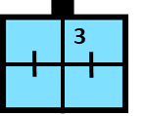





Strategic
Reception
Staging
Onward Movement
Belawan
National Staging Points
Kuala Lumpar
Medan

Slide 4

Strategic
Reception
Staging
Onward Movement
Belawan
National Staging Points
Kuala Lumpar
Medan

Slide 5
OCCUPIED
DISCREDITED
SECURED & PROTECTED
SECURED

Slide 6
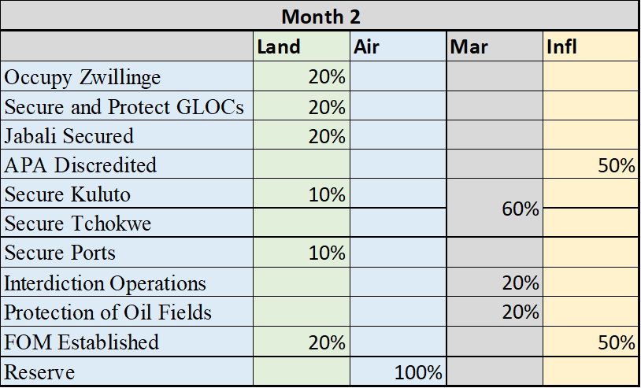
ESTABLISHED
MAINTAINED
ESTABLISHED

Slide 7
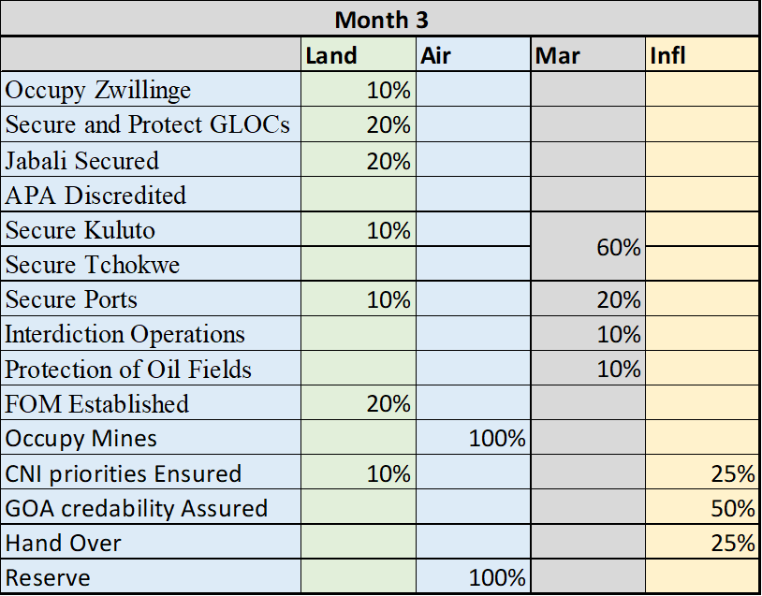
OCCUPIED
ENSURED
HAND OVER
ASSURED

